Slide 1
Welcome!
MiniPlay goes here.
‹#›

Slide 2
6.1 File Reading Basics
6.2 Details of Token-based Processing
PROFESSOR RAMSEY
GDC 6.318
ramsey@cs.utexas.edu
Notes:
changes - start with simple data file for hours 0.txt, then add loop for end of file, then add also checking for type, transition from hours0, then 1 then 2.
create picture of stream in scanner, with pointer, to visualize data file before looking at code
maybe change handout to be hours1.data, with meaningful string in the mix

Slide 3
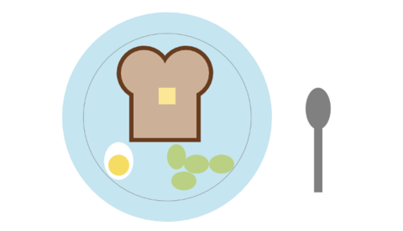
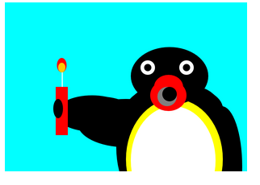
Announcements - A Few Favorites
All CS No BS
Akilesh
Kaylee’s Koders
720 Tenquins

Slide 4
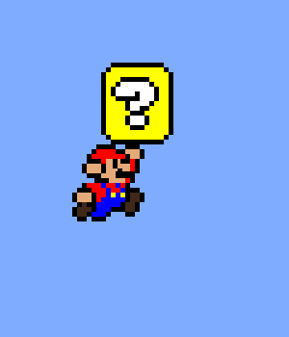
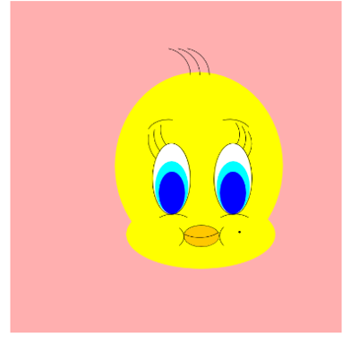
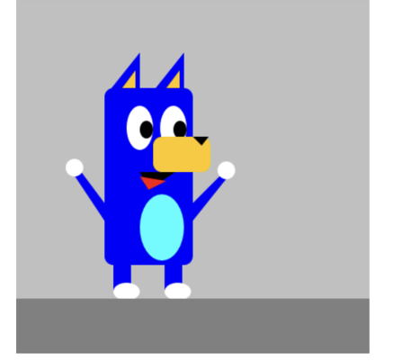
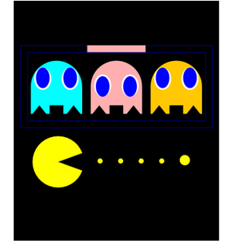
Announcements - A Few Favorites
​​
AnimaniaCS, Dia
Better Code Saul
Kevin’s Kids
720 Tenquins

Slide 5
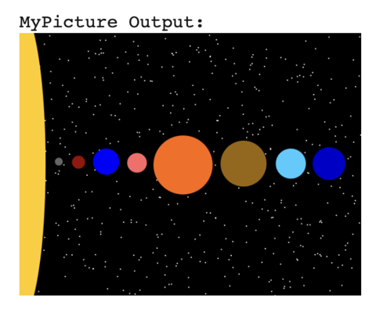
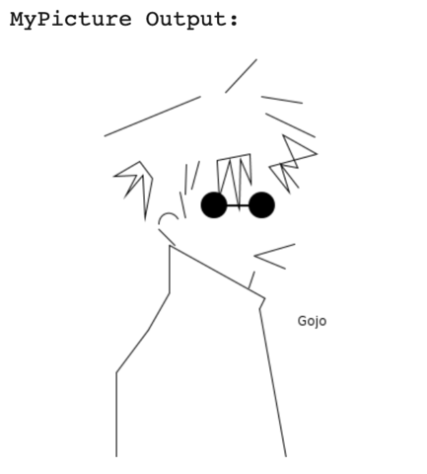
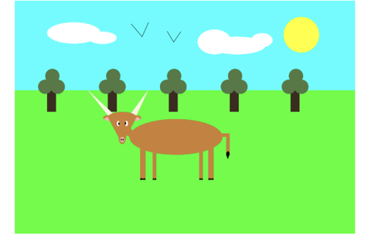
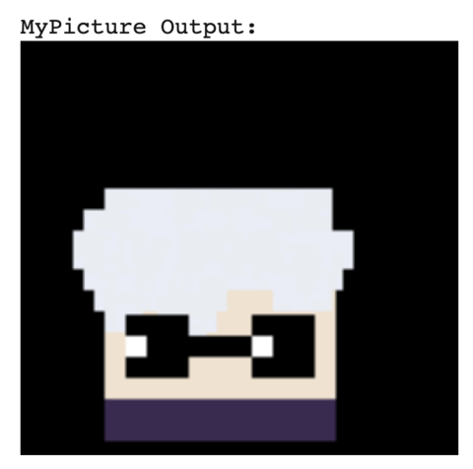
Announcements - A Few Favorites
​​
Buff Kangaroos

Slide 6
5.5 Quiz

Slide 7
6.1
File Reading Basics
Notes:
Session Title: Project Based Learning (PBL) for Equity in CS classes
Session Description: If you are teaching a survey course like Computer Science Principles, or a code intensive course like AP CS A, PBL can serve as a powerful tool to increase student interest and engagement. Learn about research that connects PBL to improved student outcomes, especially for girls and underrepresented minorities. Discover available PBL resources and understand PBL lesson components, so you can build your own.

Slide 8
File Reading Basics
Create a File object to get info about a file on your drive. (This doesn't actually create a new file on the hard disk.)
File f = new File("example.txt");
if (f.exists() && f.length() > 1000) {
f.delete();
}
Java objects we know so far: String, Graphics, Color, Scanner, File.

Slide 9
Review 1
Java Primitive Types
int, double, char, boolean
Built into the core Java language
Can use operators (++, >=, etc.)
To create:
int num;
boolean valid;
Java Objects
String, Graphics, Color, Scanner, File
Part of Java, sometimes require an import
Can not use operators (except + for String)
To create (except for String):
Scanner console = new Scanner (System.in);
File f = new File (“input.txt”);
Can call methods for the object:
console.nextInt();
console.close();

Slide 10
Review 2
<Type> <variableName>
Just like int num
<new> <objectType> <parameters>
Keyword new tells Java to create an object
objectType tells Java which type of object (It is redundant, I know)
Parameters required by the new object are sent
Scanner console = new Scanner (System.in);

Slide 11
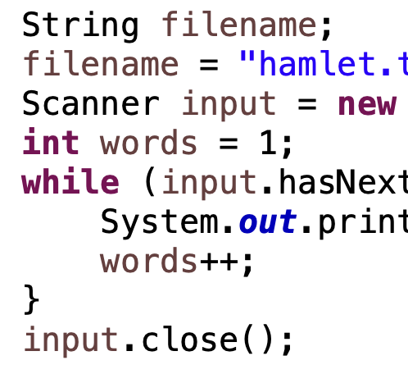
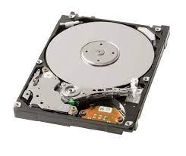
Scanner and File Objects
Code Scanner File OS & Disk
Object Object
Knows how to handle program input and output
Knows how to handle files

Slide 12
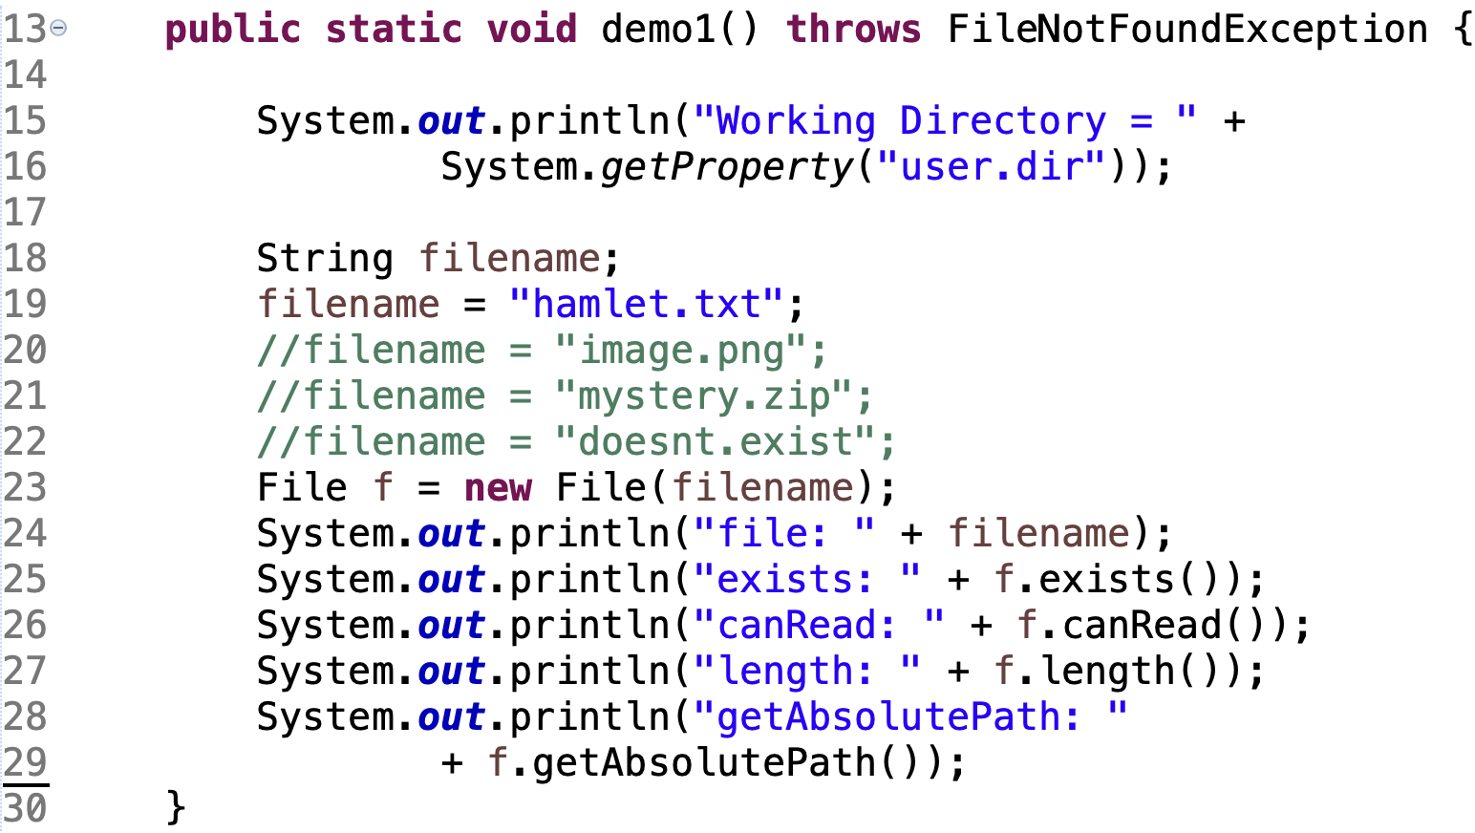
Demo1()
File Reading Basics
Demo

Slide 13
Reading Files
To read a file, your need a Scanner and File objects.
Scanner - Manages input and output to a program.
File - Manages reading from and writing to a file.
A File object is sent as a parameter to the Scanner object.
Scanner name = new Scanner(new File("file name"));
Requires two imports:
import java.util.*; // for Scanner object
import java.io.*; // for File object
Example:
File file = new File("mydata.txt");
Scanner input = new Scanner(file);
or (shorter):
Scanner input = new Scanner(new File("mydata.txt"));

Slide 14
File Paths
absolute path: specifies a drive or a top "/" folder
C:/Documents/smith/hw6/input/data.csv
relative path: does not specify any top-level folder
names.dat
input/kinglear.txt
Assumed to be relative to the current directory:
Scanner input = new Scanner(new File("data/readme.txt"));
In this case, Java will look for the file in the data subdirectory of the project directory.

Slide 15
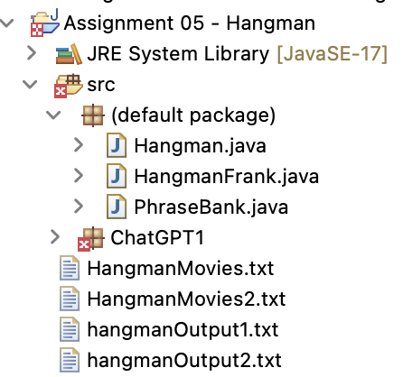
File Paths
If our program is in Eclipse project Assignment01:
Java file is in Assignment01/src
Data files are in Assignment01

Slide 16
File Methods

Slide 17
Files and Compiler Errors
import java.io.*; // for File
import java.util.*; // for Scanner
public class ReadFile {
public static void main(String[] args) {
Scanner input = new Scanner(new File("data.txt"));
String text = input.next();
System.out.println(text);
}
}
The program fails to compile with the following error:
ReadFile.java:6: unreported exception java.io.FileNotFoundException;
must be caught or declared to be thrown
Scanner input = new Scanner(new File("data.txt"));

Slide 18
Exceptions
exception: An object representing a runtime error.
dividing an integer by 0
calling substring on a String and passing too large an index
trying to read the wrong type of value from a Scanner
trying to read a file that does not exist
We say that a program with an error "throws" an exception. It is also possible to "catch" (handle or fix) an exception.
checked exception: An error that must be handled by our program (otherwise it will not compile). We must specify how our program will handle file I/O failures.

Slide 19
throws()
throws clause: Keywords on a method's header that state that it may generate an exception (and will not handle it).
public static type name(params) throws type {
Example:
public class ReadFile {
public static void main(String[] args)
throws FileNotFoundException {
Like saying, "I hereby announce that this method might throw an exception, and I accept the consequences if this happens."

Slide 20
Prompting for a Filename
We can ask the user to tell us the file to read. The filename might have spaces; use nextLine(), not next()
// prompt for input file name
Scanner console = new Scanner(System.in);
System.out.print("Type a file name to use: ");
String filename = console.nextLine();
Scanner input = new Scanner(new File(filename));
Files have an exists method to test for file-not-found:
File file = new File("hours.txt");
if (!file.exists()) {
// try a second input file as a backup
System.out.print("hours file not found!");
file = new File("hours2.txt");
}
‹#›

Slide 21
6.2
Details of Token-Based Processing
Notes:
Session Title: Project Based Learning (PBL) for Equity in CS classes
Session Description: If you are teaching a survey course like Computer Science Principles, or a code intensive course like AP CS A, PBL can serve as a powerful tool to increase student interest and engagement. Learn about research that connects PBL to improved student outcomes, especially for girls and underrepresented minorities. Discover available PBL resources and understand PBL lesson components, so you can build your own.

Slide 22
Remember Console Output
Console output consists of lines/rows and columns (ASCII-based, non-proportional fonts)
Print one line at a time.
Within one line, print one character/column at a time.
#####
|||||
|||||
|||||
|||||
#####
~~~~~~~~~
|-O-O-O-|
~~~~~~~~~
|-O-O-O-|
~~~~~~~~~
|-O-O-O-|
~~~~~~~~~
|-O-O-O-|
~~~~~~~~~
|-O-O-O-|
~~~~~~~~~
|-O-O-O-|
~~~~~~~~~
|-O-O-O-|
~~~~~~~~~
|-O-O-O-|
~~~~~~~~~
|-O-O-O-|
~~~~~~~~~
/"'"'"'"'"'"'"'"'"'"'"'"'"\
/"'"'"'"'"'"'"'"'"'"'"'"'"'"'"'"\
/"O"O"O"O"O"O"O"O"O"O"O"O"O"O"O"\
/"O"O"O"O"O"O"O"O"O"O"O"O"O"O"O"\
/"O"O"O"O"O"O"O"O"O"O"O"O"O"O"O"\

Slide 23
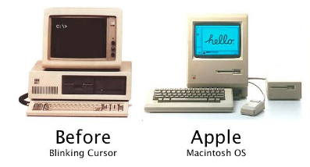
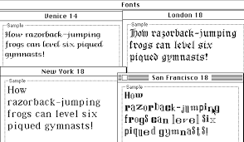
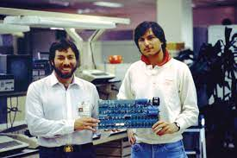
A Look at Proportional Fonts

Slide 24
File Input
File input consists of lines/rows and columns (ASCII-based text, non-proportional fonts).
Read one line at a time.
Within one line, read one token at a time.
Tokens are separated by whitespace.
College Men's Soccer
2006
2006-08-22 @Cal Baptist 3 CS San Marcos 2 O1
2006-08-22 Crichton 0 @Wm Carey 6
2006-08-22 @Houghton 0 Rio Grande 5
2006-08-22 Huntington 3 @Calumet 2
2006-08-23 Davenport 0 @Bethel IN 3
2006-08-23 Park 5 @Midland 0
2006-08-23 @College of SW 2 Embry-Riddle AZ 0

Slide 25
Input Tokens
token: A unit of user input, separated by whitespace.
A Scanner splits a file's contents into tokens.
If an input file contains the following:
23 3.14
"John Smith"
The Scanner can interpret the tokens as the following types:
Token Type(s)
23 int, double, String
3.14 double, String
"John String (quote is taken literally)
Smith" String
Whitespace includes spaces, tabs (\t) and newlines (\n)

Slide 26
Files and Input Cursor
Consider a file weather.txt that contains this text:
16.2 23.5
19.1 7.4 22.8
18.5 -1.8 14.9
A Scanner views all input as a stream of characters:
16.2 23.5\n19.1 7.4 22.8\n\n18.5 -1.8 14.9\n
^
input cursor: The current position of the Scanner.

Slide 27
Consuming Tokens
consuming input: Reading input and advancing the cursor.
Calling next etc. moves the cursor past the current token.
16.2 23.5\n19.1 7.4 22.8\n\n18.5 -1.8 14.9\n
^
double d = input.nextDouble(); // 16.2
16.2 23.5\n19.1 7.4 22.8\n\n18.5 -1.8 14.9\n
^
String s = input.next(); // "23.5"
16.2 23.5\n19.1 7.4 22.8\n\n18.5 -1.8 14.9\n
^
double e = input.nextDouble(); // 19.1

Slide 28
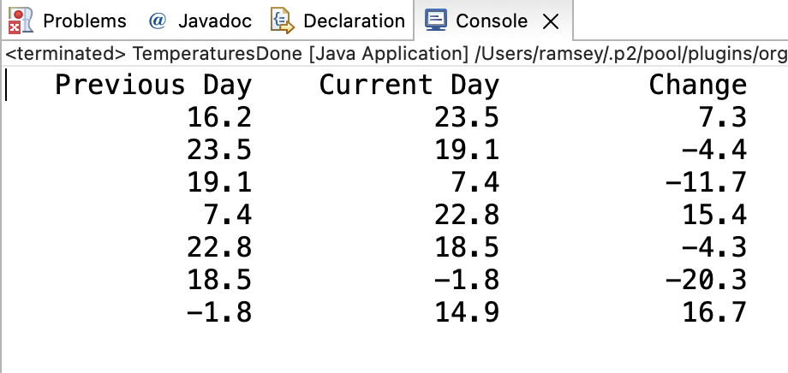
Demo
Demo 1 - Write a method that reads 8 temperatures, then prints the change in temperature between each pair of neighboring days.
Input file weather.txt: Output:
16.2 23.5
19.1 7.4 22.8
18.5 -1.8 14.9

Slide 29
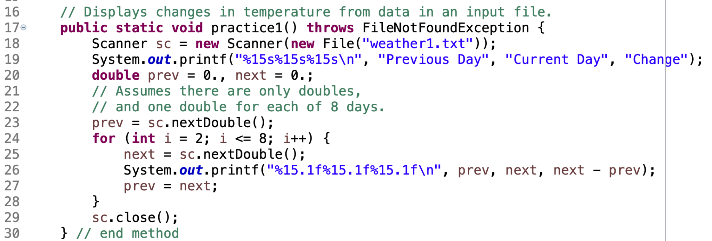
Demo Code

Slide 30
Reading an Entire File
Suppose we want our program to work no matter how many numbers are in the file.
Currently, if the file has more numbers, they will not be read.
If the file has fewer numbers, what will happen?
A crash! Example output from a file with just 3 numbers:
16.2 to 23.5, change = 7.3
23.5 to 19.1, change = -4.4
Exception in thread "main" java.util.NoSuchElementException
at java.util.Scanner.throwFor(Scanner.java:838)
at java.util.Scanner.next(Scanner.java:1347)
at Temperatures.main(Temperatures.java:12)

Slide 31
Scanner Exceptions
Common exceptions:
NoSuchElementException: You read past the end of the input.
InputMismatchException: You read the wrong type of token (e.g. read "hi" as an int)
Finding and fixing these exceptions:
Read the exception text for line numbers in your code (the first line that mentions your file; often near the bottom):
Exception in thread "main" java.util.NoSuchElementException
at java.util.Scanner.throwFor(Scanner.java:838)
at java.util.Scanner.next(Scanner.java:1347)
at MyProgram.myMethodName(MyProgram.java:19)
at MyProgram.main(MyProgram.java:6)

Slide 32
Modify the last method to ignore a token that is not a double and run until no tokens are left in the file. The last method is below.
In-Class Practice

Slide 33
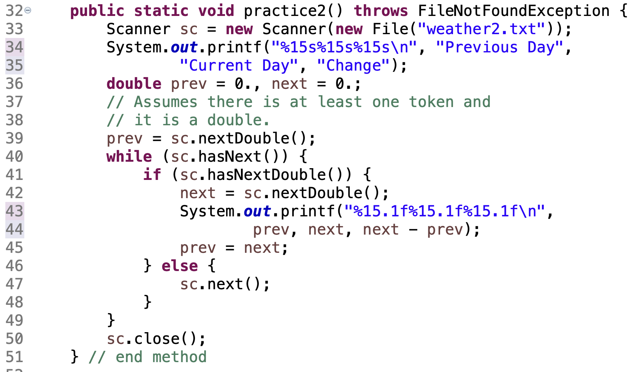
Solution

Slide 34
Remember
You Belong Here
TBD
Hi!

